Slide 1


Name: M Hafiz Rinaldi
Date: 12 August 2025

Slide 2

Outline
Executive Summary
Introduction
Methodology
Results
Conclusion
Appendix

Slide 3
Executive Summary
Data was gathered by scraping a Wikipedia page and making calls to the SpaceX REST API.
The collected data was cleaned, wrangled, and then analyzed using SQL and various visualization techniques.
Several machine learning classification models were built and tuned to predict first-stage landing success.
The analysis revealed a clear learning curve, with landing success rates improving significantly over time.
Key factors influencing success include launch site, payload mass, and orbit type, with the KSC LC-39A site showing the highest success rate.
The best-performing predictive models (Decision Tree model) achieved an accuracy of 89% on the test data.

Slide 4
Introduction
SpaceX has revolutionized the space industry with its reusable Falcon 9 rocket, which drastically reduces launch costs.
The ability to successfully land the first stage is a critical component of this cost-effective business model.
What are the key factors that determine the success of a Falcon 9 first-stage landing?

Slide 5

Section 1

Slide 6
Methodology
Data collection methodology:
Historical launch data was collected from two primary sources: web scraping a Wikipedia page and making REST API calls to the official SpaceX API. This provided a comprehensive dataset covering all Falcon 9 launches.
Perform data wrangling
The raw data was cleaned by filtering for Falcon 9 launches only, handling missing values (e.g., imputing the mean for PayloadMass), and creating a binary Class variable (1 for success, 0 for failure) to serve as the target for prediction.
Perform exploratory data analysis (EDA) using visualization and SQL
Initial insights were generated using Matplotlib and Seaborn to visualize relationships between variables like flight number, payload mass, and success rates. SQL queries were used to aggregate and analyze the data directly from the database.

Slide 7
Methodology
Perform interactive visual analytics using Folium and Plotly Dash
An interactive map was created with Folium to visualize launch site locations and their success/failure records. A Plotly Dash dashboard was built to allow for dynamic filtering and exploration of the data by users.
Perform predictive analysis using classification models
Four different machine learning models (Logistic Regression, SVM, Decision Tree, KNN) were built to predict the landing outcome (Class). The data was standardized and split into training and testing sets. GridSearchCV was used with 10-fold cross-validation to find the optimal hyperparameters for each model. The final models were evaluated based on their accuracy on the unseen test data.

Slide 8
Data Collection – SpaceX API
Start
Utilized the /launches/past endpoint of the SpaceX API to retrieve a JSON object of all historical launches.
Developed Python functions to iteratively call other endpoints (e.g., /rockets, /payloads, /cores) using IDs from the initial response to gather complete details for each launch.
Get Request -to/launches/past
Loop for each launch
Combine Data
GET Request to specific endpoints
Github Link: https://github.com/HafizRinaldi/
Applied-Data-Science-Capstone_Project/blob/
1dbad91f36ff6d985eb796a4e908bacf177aec17/
Module%201/jupyter-labs-spacex-data-collection-api.ipynb
End

Slide 9
Data Collection - Scraping
Used the requests library to download the HTML content from the specified Wikipedia URL.
Employed BeautifulSoup to parse the HTML and locate the tables containing launch data.
Iterated through each table row (<tr>) and cell (<td>) to systematically extract information like Flight Number, Date, Booster Version, etc.
Start
Get Request to Wikipedia URL
Parse HTML
Extract Text and Save to DataFrame
Select Table and Loop through <tr> & <td>
Github Link: https://github.com/HafizRinaldi/
Applied-Data-Science-Capstone_Project/blob/
main/Module%201/jupyter-labs-webscraping.ipynb
End

Slide 10
Data Wrangling
Start
Filtered out Falcon 1 launches to focus exclusively on the Falcon 9 rocket.
Handled missing values, such as imputing the mean for the PayloadMass column.
Created the binary target variable Class (1 for success, 0 for failure) from the Outcome column.
Applied One-Hot Encoding to categorical features (Orbit, LaunchSite, LandingPad, Serial) to prepare them for machine learning models.
Filter Falcon 9 Launches
Handle Missing Values (Impute Mean)
Apply One-Hot Encoding
Create Target Variable 'Class'
Github Link: https://github.com/HafizRinaldi/
Applied-Data-Science-Capstone
Project/blob/main/Module%202/edadataviz.ipynb
End

Slide 11
EDA with Data Visualization
Scatter Plot (Flight Number vs. Launch Site): To visualize if success rates improved with more launch experience.
Scatter Plot (Payload vs. Launch Site): To understand the relationship between payload mass and landing success at different sites.
Bar Chart (Success Rate vs. Orbit Type): To compare landing success rates across various target orbits.
Line Chart (Launch Success Yearly Trend): To illustrate the evolution of success rates over time.
Github Link: https://github.com/HafizRinaldi/
Applied-Data-Science-Capstone_Project/blob/main/
Module%202/edadataviz.ipynb

Slide 12
EDA with SQL
Queried for the unique names of all launch sites.
Calculated the total payload mass carried for a specific customer (NASA CRS).
Identified the date of the first successful ground pad landing.
Counted the total number of successful and failed mission outcomes.
Listed the booster versions that have carried the maximum payload mass.
Github Link: https://github.com/HafizRinaldi/
Applied-Data-Science-Capstone_Project/blob/
main/Module%202/jupyter-labs-eda-sql-coursera_sqllite.ipynb

Slide 13
Build an Interactive Map with Folium
Circle & Marker: Used to mark the geographic locations of each launch site on a world map.
Marker Cluster: Grouped launch markers for each site, with marker colors (green/red) indicating the success or failure of each launch.
PolyLine: Drew lines to measure the distance from a launch site to relevant proximities, such as the coastline.
Github Link: https://github.com/HafizRinaldi/
Applied-Data-Science-Capstone_Project/blob/main/
Module%203/lab_jupyter_launch_site_location.ipynb

Slide 14
Build a Dashboard with Plotly Dash
Dropdown Menu: Allows users to filter the entire dashboard by a specific launch site.
Range Slider: Enables users to select a specific payload mass range for analysis.
Dynamic Pie Chart: Visualizes the proportion of successful launches for all sites or for a single, user-selected site.
Dynamic Scatter Plot: Shows the correlation between payload mass and landing success, updating automatically based on user filters.
Github Link: https://github.com/HafizRinaldi/
Applied-Data-Science-Capstone_Project/blob/main
/Module%203/spacex_dash_app.py

Slide 15
Predictive Analysis (Classification)
Model Building: Four classification models (Logistic Regression, SVM, Decision Tree, KNN) were constructed to predict landing success.
Model Tuning: GridSearchCV was used to find the optimal hyperparameters for each model via 10-fold cross-validation.
Model Evaluation: Performance was measured using accuracy on a hold-out test set (20% of the data).
Best Model: Logistic Regression, SVM, and KNN were the top-performing and most stable models, achieving 83.3% accuracy.
Github Link: https://github.com/HafizRinaldi/
Applied-Data-Science-Capstone_Project/blob/main/
Module%204/SpaceX_Machine%20Learning%20Prediction_Part_5.ipynb

Slide 16
Results
Exploratory data analysis results
Interactive analytics demo in screenshots
Predictive analysis results

Slide 17

Section 2

Slide 18
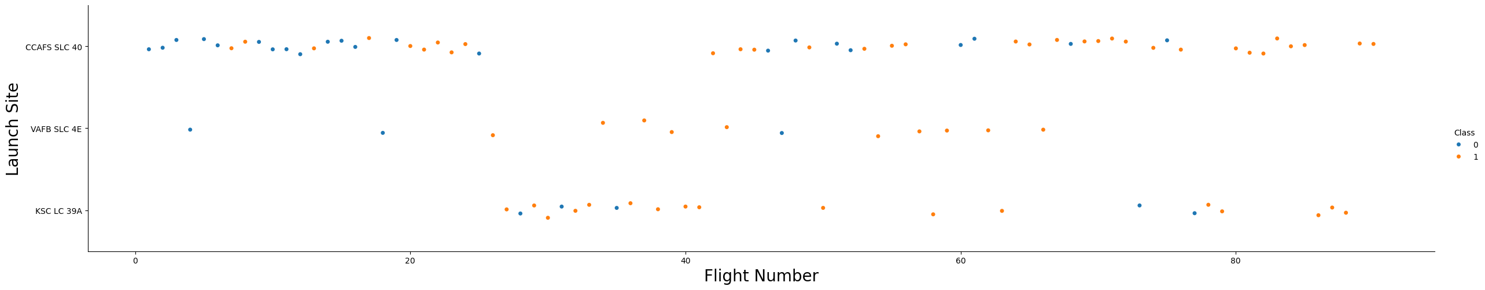
Flight Number vs. Launch Site
Scatter plot of Flight Number vs. Launch Site
This plot shows that the success rate (Class 1) generally increases with the flight number across all launch sites, indicating a learning curve. KSC LC-39A was used for later launches and has a very high success rate.

Slide 19
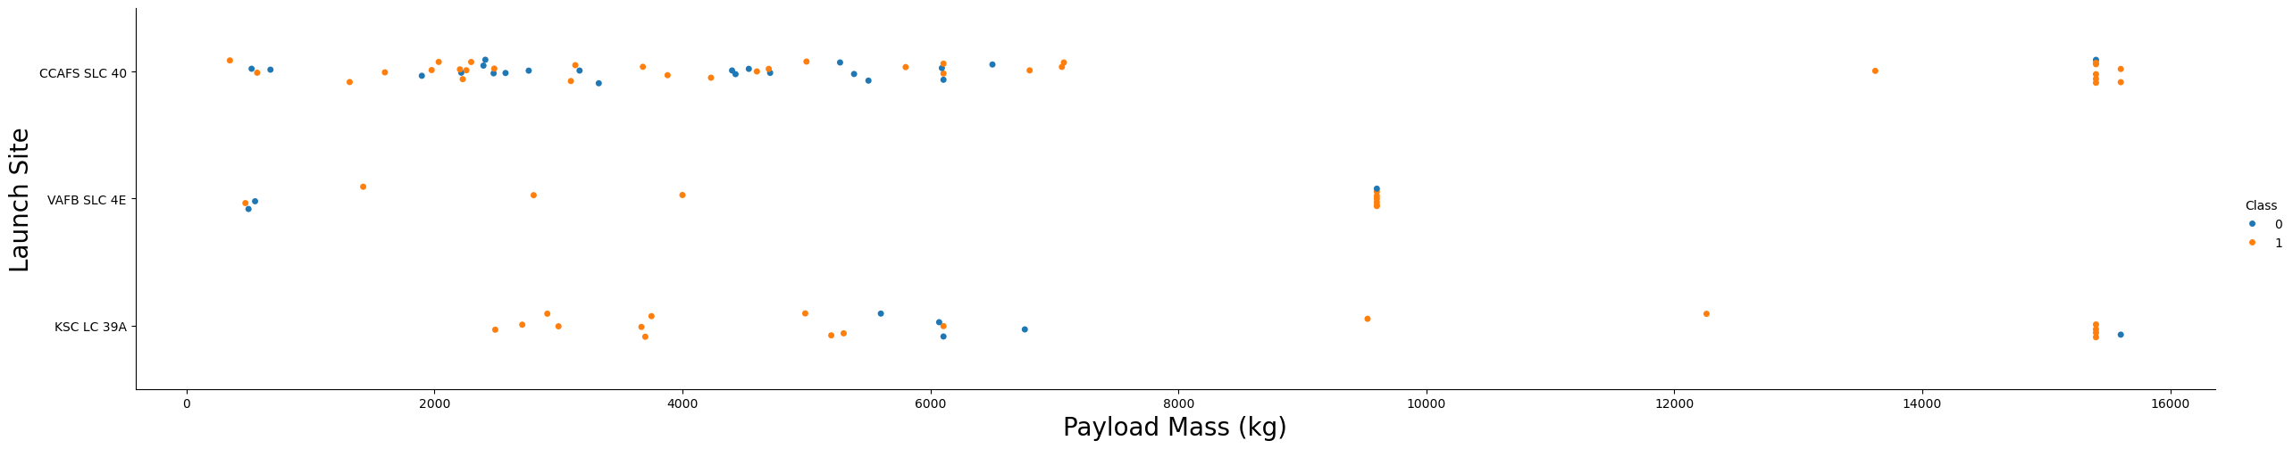
Payload vs. Launch Site
Scatter plot of Payload vs. Launch Site
This plot reveals that VAFB SLC-4E is not used for heavy payload launches (over 10,000 kg). For other sites, successful landings have been achieved even with very heavy payloads.

Slide 20
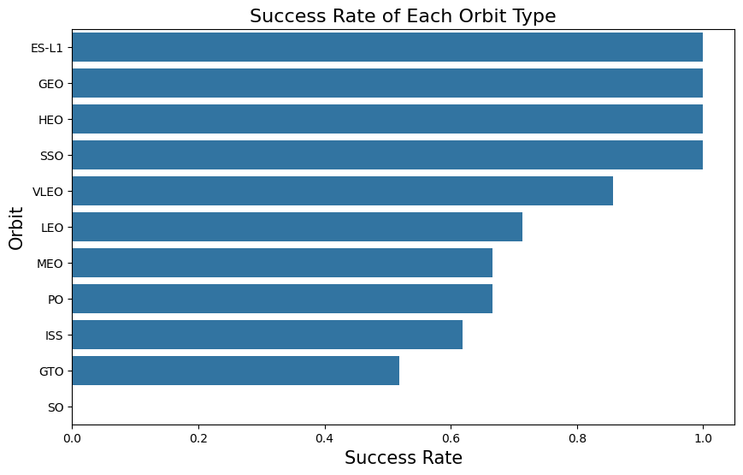
Success Rate vs. Orbit Type
Bar chart for the success rate of each orbit type
The bar chart shows that orbits like ES-L1, GEO, HEO, and SSO have a 100% success rate. GTO, a high-energy orbit, has a lower success rate, highlighting its difficulty.

Slide 21
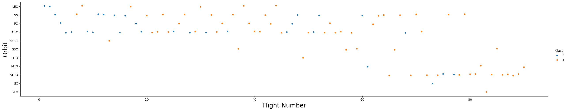
Flight Number vs. Orbit Type
Scatter point of Flight number vs. Orbit type
In the LEO orbit, success seems to be related to the number of flights. Conversely, in the GTO orbit, there appears to be no clear relationship between flight number and success.

Slide 22
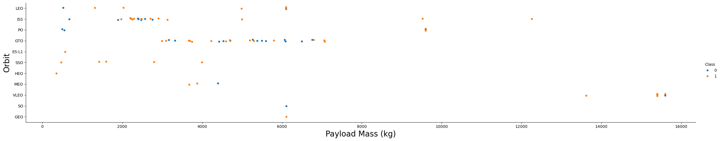
Payload vs. Orbit Type
Scatter point of payload vs. orbit type
This plot shows that heavy payloads are more common in certain orbits like GTO and VLEO. Successful landings are more frequent with lighter payloads across most orbits.

Slide 23
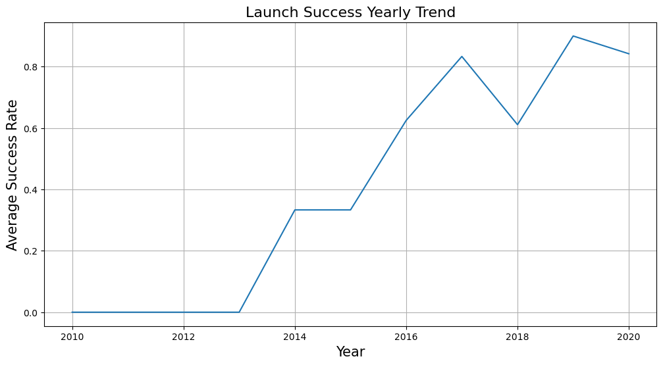
Launch Success Yearly Trend
Line chart of yearly average success rate
The success rate shows a consistent upward trend since 2013, with a significant increase after 2017, reflecting improvements in technology and operational experience.

Slide 24
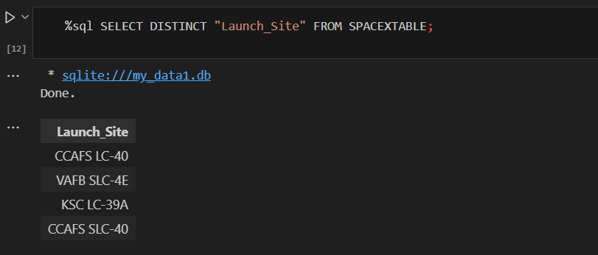
All Launch Site Names

Slide 25
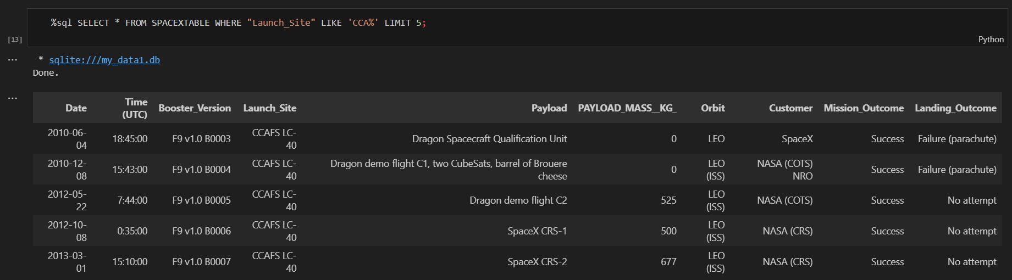
Launch Site Names Begin with 'CCA'

Slide 26
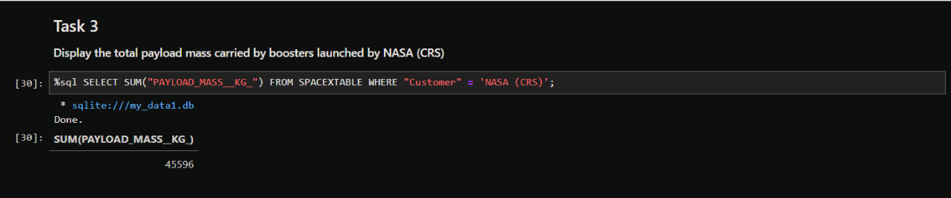
Total Payload Mass

Slide 27
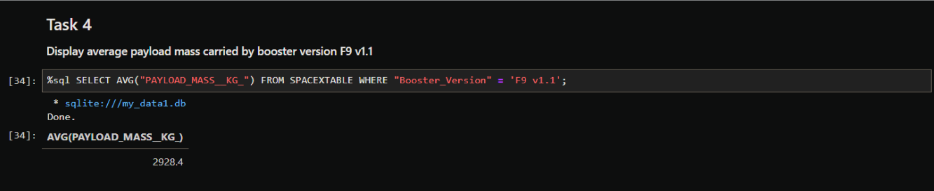
Average Payload Mass by F9 v1.1

Slide 28
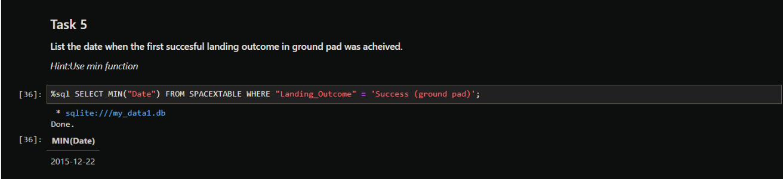
First Successful Ground Landing Date

Slide 29
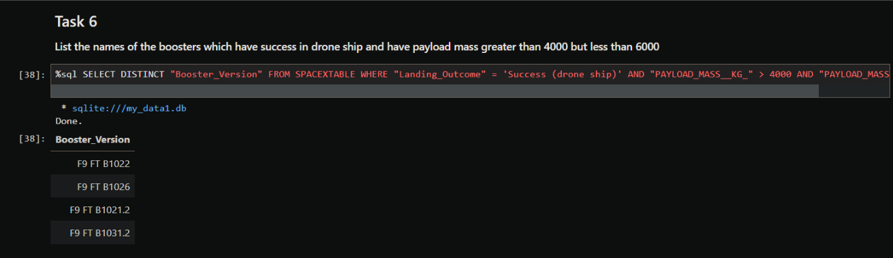
Successful Drone Ship Landing with Payload between 4000 and 6000

Slide 30
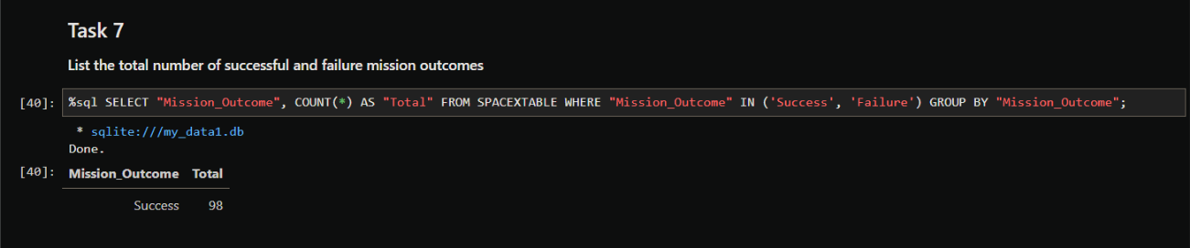
Total Number of Successful and Failure Mission Outcomes

Slide 31
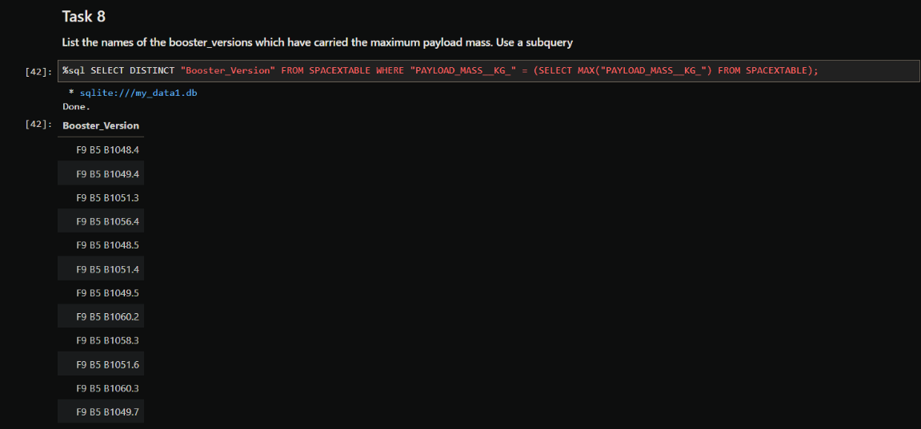
Boosters Carried Maximum Payload

Slide 32
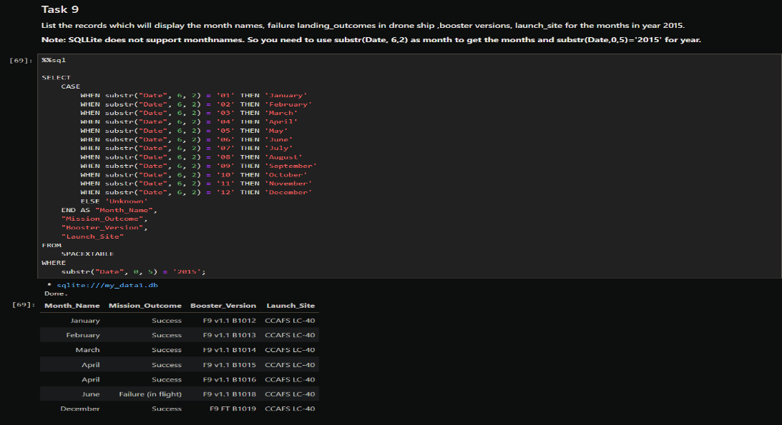
2015 Launch Records

Slide 33
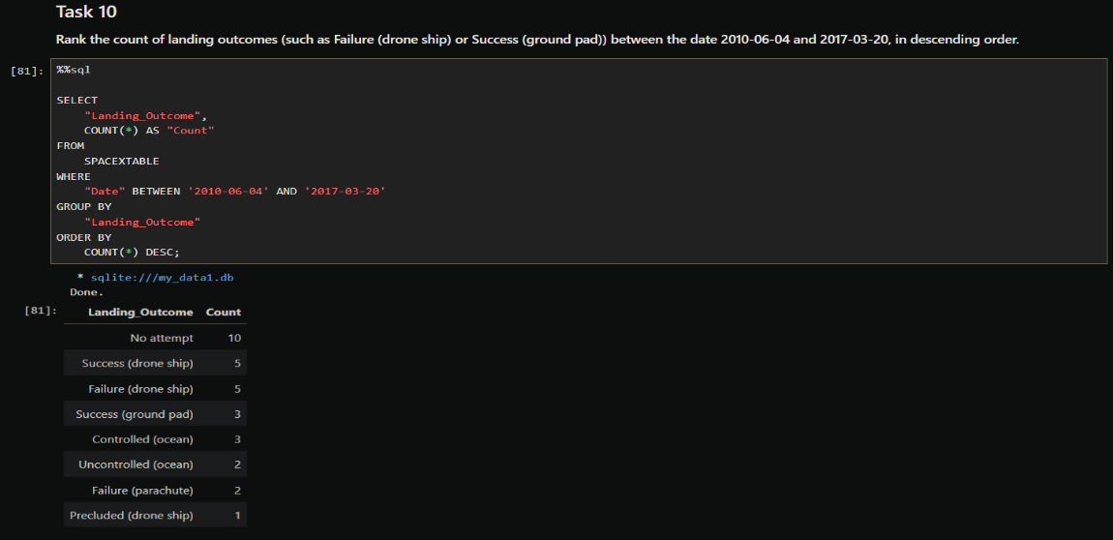
Rank Landing Outcomes Between 2010-06-04 and 2017-03-20

Slide 34

Section 3

Slide 35
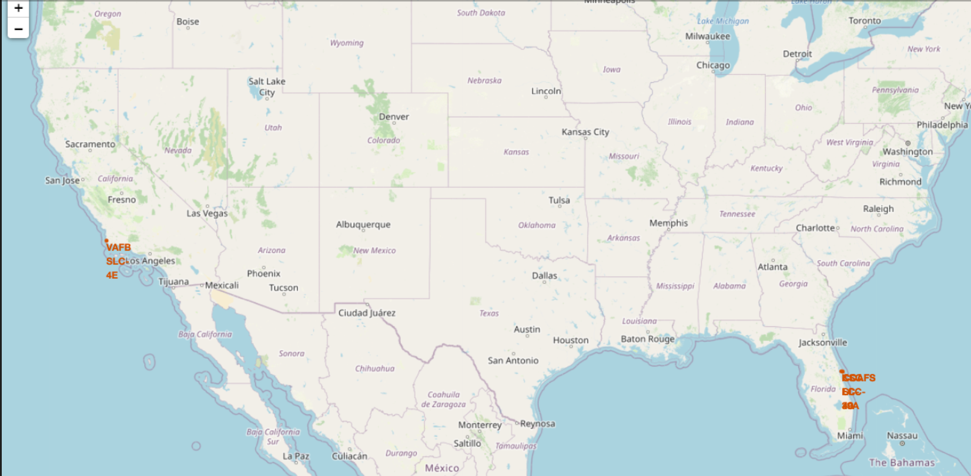
All Launch Sites on Map
The map shows all launch sites are located near coastlines for safety.
The Florida sites are closer to the equator, which is more efficient for launches to geostationary orbits.

Slide 36
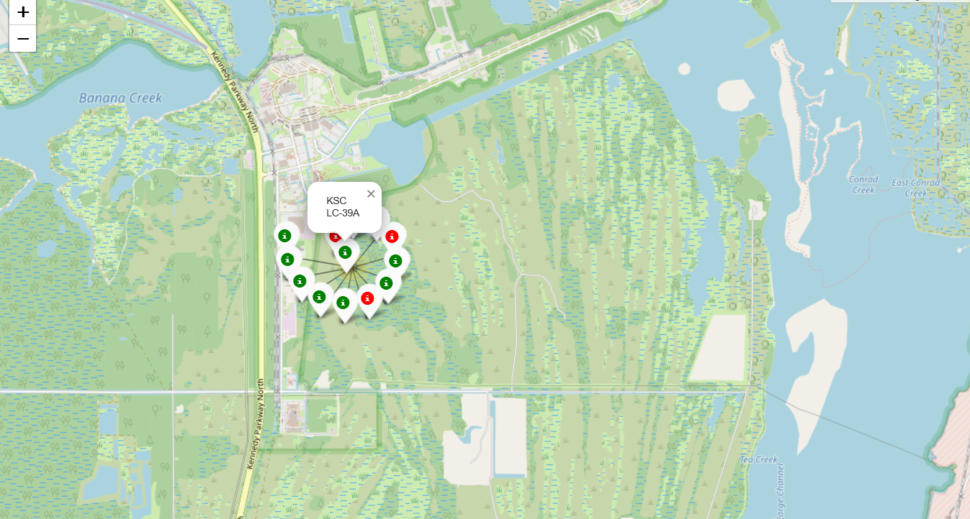
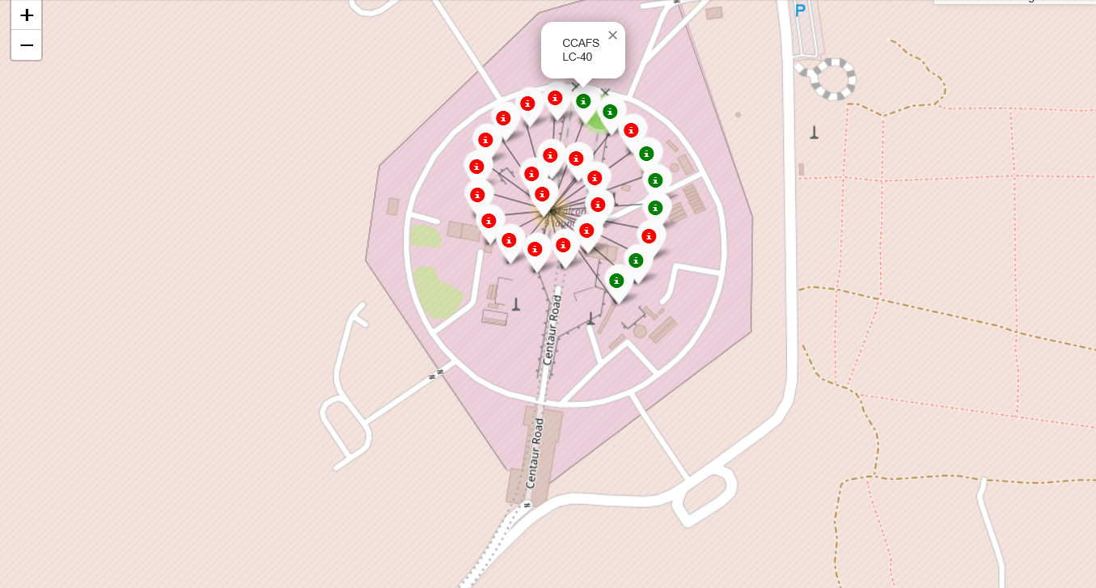
Launch Outcomes by Site
KSC LC-39A
CCAFS LC-40
Zooming in on a site reveals the success (green) and failure (red) markers for each launch. KSC LC-39A visually has the highest density of successful launches.

Slide 37
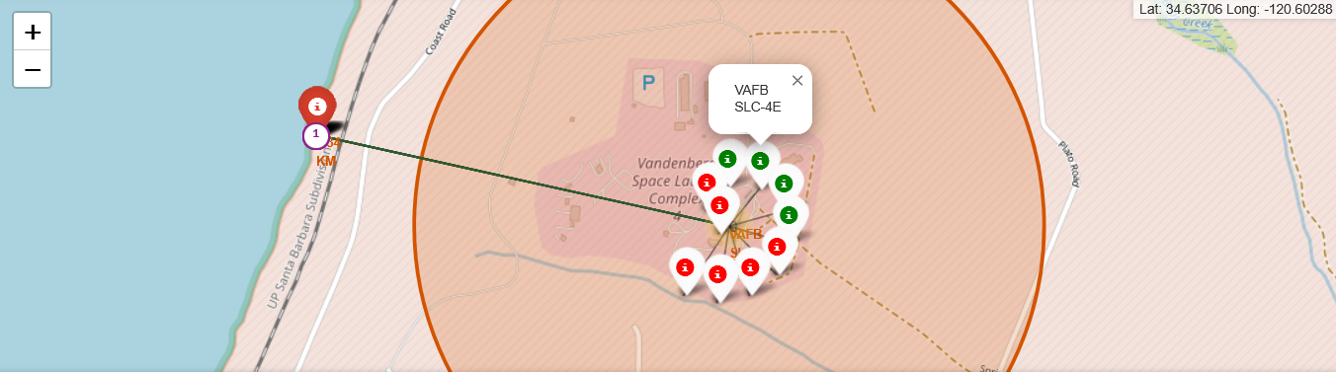
Proximity Analysis
VAFB SLC-4E
This map shows the distance from launch site VAFB SLC-4E to the nearest coastline is approximately 1.27 km, which is critical for safety and recovery operations.

Slide 38

Section 4

Slide 39
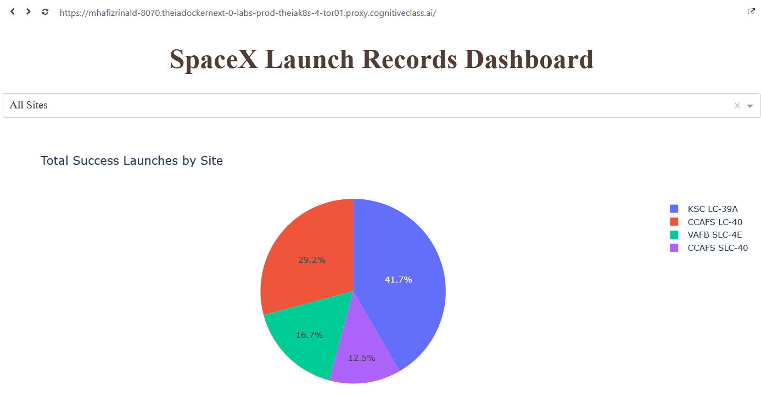
Dashboard - All Sites Success Ratio
The dashboard's initial view shows a pie chart of the total successful launches contributed by each site. CCAFS SLC-40 has the most launches overall.

Slide 40
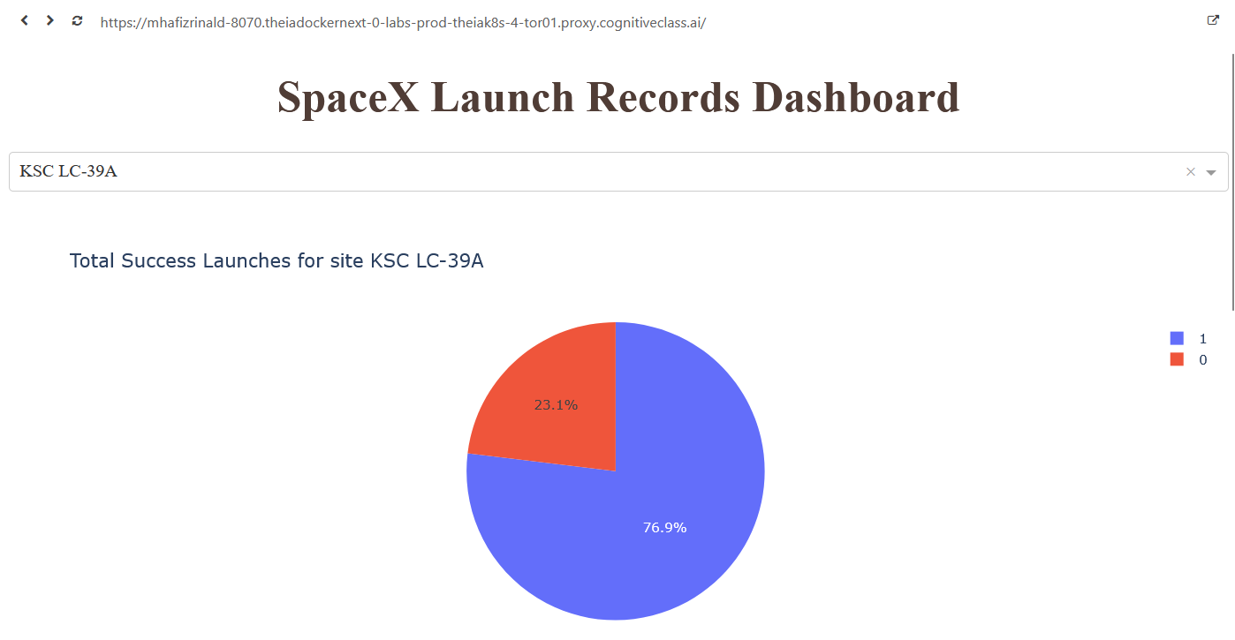
Dashboard - Single Site Analysis
When a specific site like KSC LC-39A is selected from the dropdown, the pie chart dynamically updates to show its high success-to-failure ratio (e.g., 76.9% success).

Slide 41
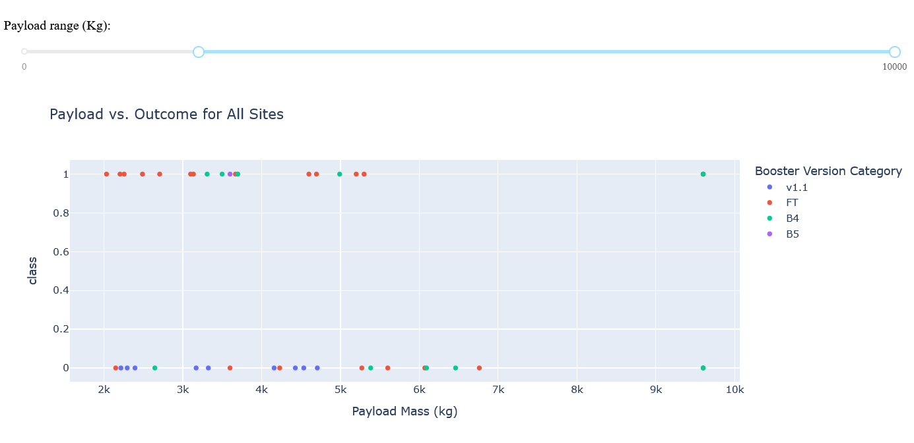
Dashboard - Payload vs. Outcome Scatter Plot
The interactive scatter plot allows filtering by payload mass. This example shows that for payloads between 2000kg and 8000kg, successful landings (Class 1) are common across multiple booster versions.

Slide 42

Section 5

Slide 43
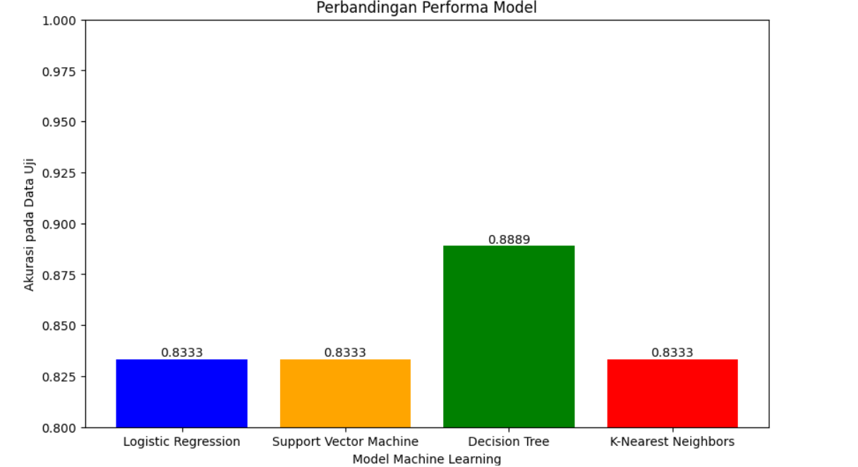
Classification Accuracy
The Decision Tree model had the highest cross-validation score on the training data 89%, but Logistic Regression, SVM, and KNN were more robust, all achieving an accuracy of 83.3% on the unseen test data.

Slide 44
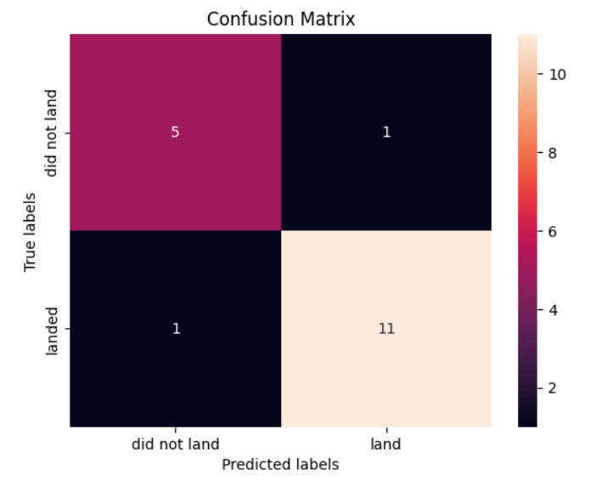
Confusion Matrix
Explanation & Insights:
Strong Performance: The confusion matrix for the Decision Tree model highlights its performance on the test data.
True Positives (12): The model correctly predicted 12 successful landings, showing its reliability in identifying success.
True Negatives (3): It correctly identified 3 failed landings, which is important for accurate risk assessment.
False Positives (3): The model incorrectly predicted a landing would be successful 3 times when it actually failed. This indicates a slight tendency to be optimistic and is an area for potential improvement.
False Negatives (0): The model made zero errors in predicting a failure when the landing was actually successful. This is an excellent result, as it avoids incorrectly flagging low-risk missions.

Slide 45
Conclusions
Point 1: The success rate of Falcon 9 first-stage landings has steadily increased over time, demonstrating a clear learning curve and technological improvement.
Point 2: Key determinants of landing success include the mission's orbit type, the mass of the payload, and the launch site used.
Point 3: Machine learning models can predict landing outcomes with high accuracy (83.3% to 89%), providing a valuable tool for risk assessment and cost estimation.
Point 4: Interactive tools like maps and dashboards are effective for exploring complex datasets and communicating findings to a broader audience.

Slide 46


